Slide 1


Project Title: Employee Management System
BY:
Talasila Omprakash
Batch:422

Slide 2


Slide 3

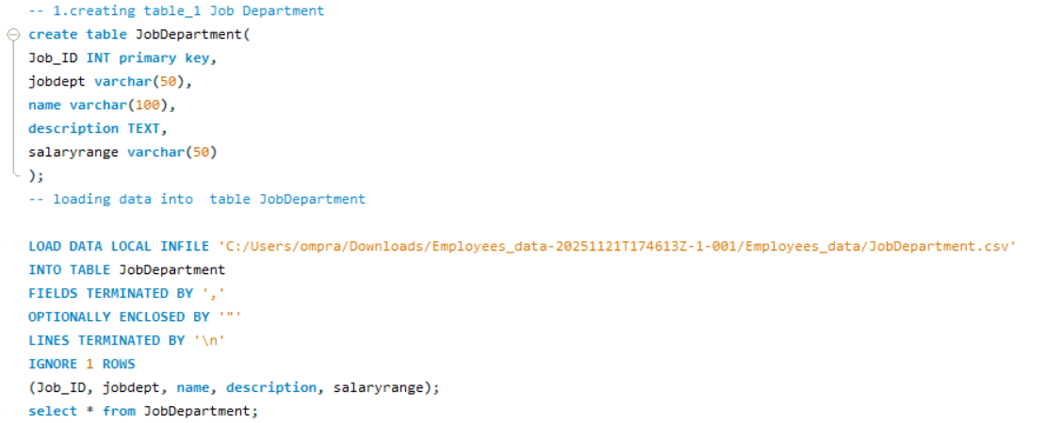
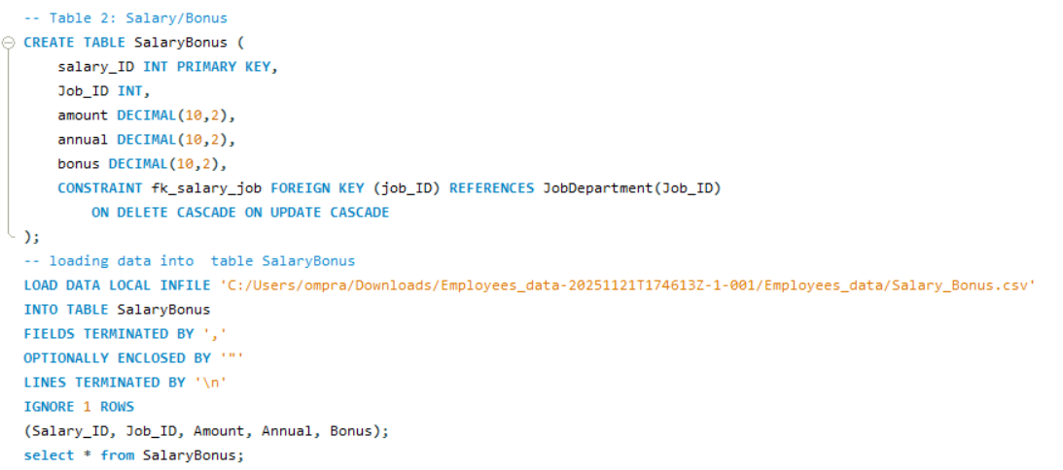
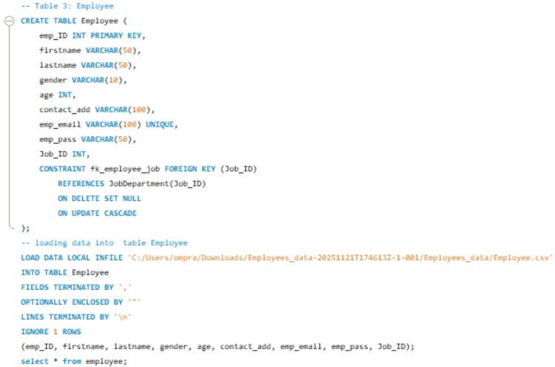
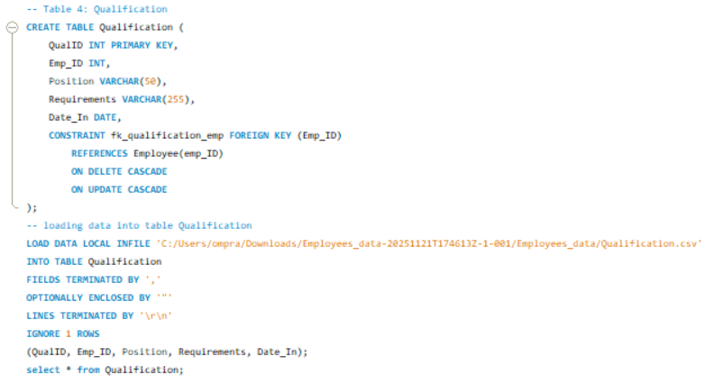
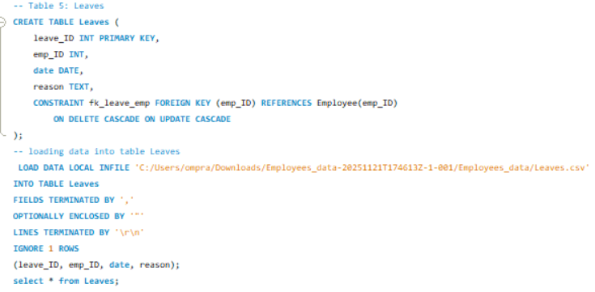
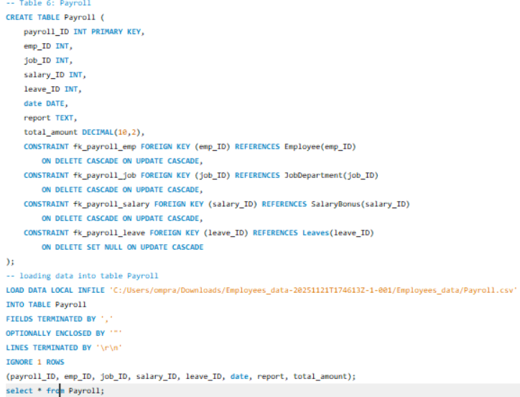
Queries For Creating Tables

Slide 4

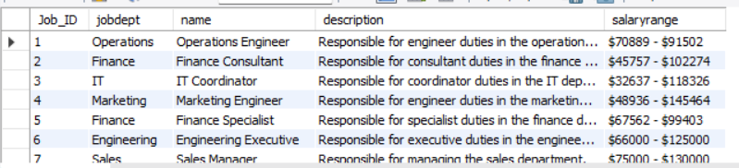
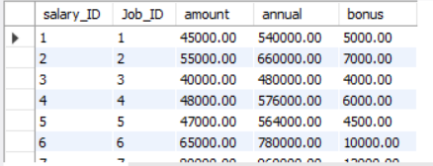
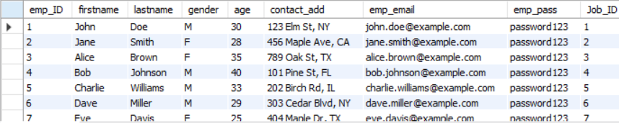
Job Department Table
Salary Bonus Table
Employee Table

Slide 5


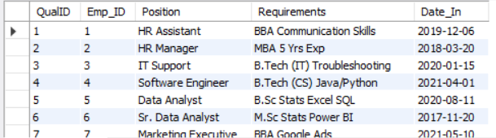
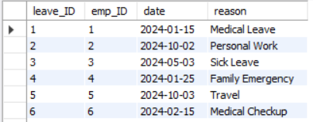

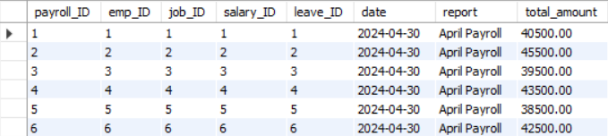
Qualification Table
Leaves TABEL
Payroll TABEL

Slide 6
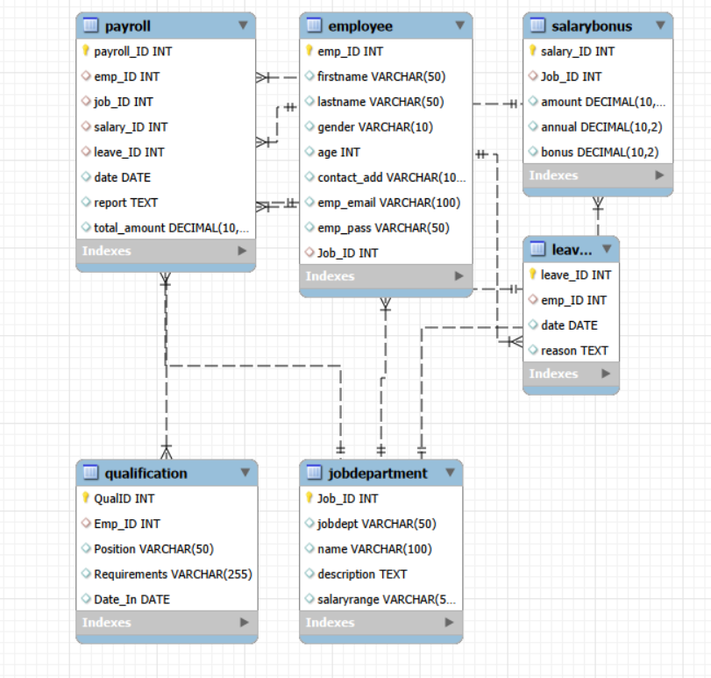
ER Diagram:
6 Tables: Employee, JobDepartment, SalaryBonus, Leaves, Qualification, Payroll
All Primary Key – Foreign Key relationships are properly validated
Follows a 1-to-many relational structure across all modules

Slide 7

Problem Statement:
The objective of this project is to design and implement an Employee Management System that efficiently stores and manages employee-related data within an organization. The system needs to track various aspects of employee information, including personal details, job roles, salary structures, qualifications, leave records, and payroll data. The system should ensure the integrity and consistency of data by using relational tables with appropriate foreign keys and cascading actions.
The system should allow for easy management and querying of employee data, providing insights such as payroll calculation, leave tracking, and department-specific job roles. The goal is to streamline HR operations, ensuring that all relevant employee data is accessible and accurately updated across different modules.

Slide 8








Analysis Questions
1. EMPLOYEE INSIGHTS
How many unique employees are currently in the system?

Slide 9
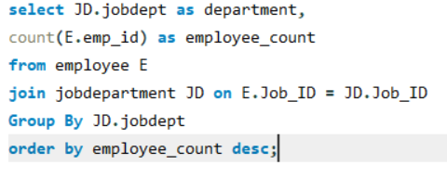
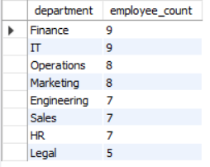
ii. Which departments have the highest number of employees?

Slide 10
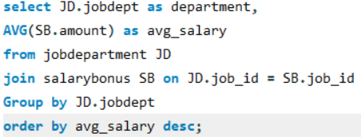
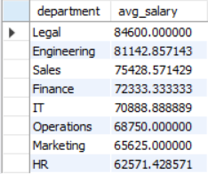
iii.What is the average salary per department?

Slide 11

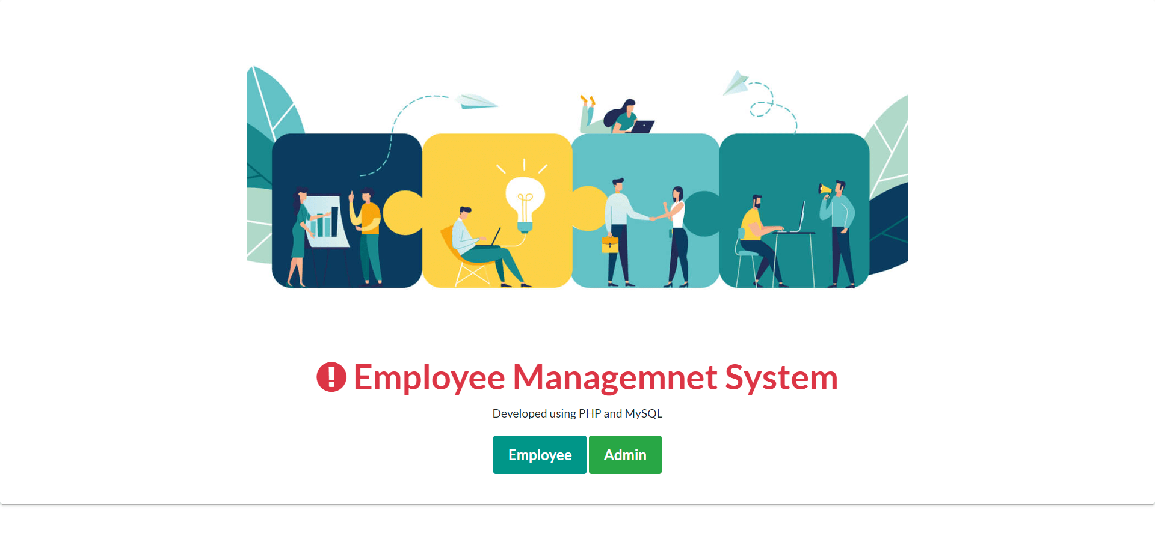
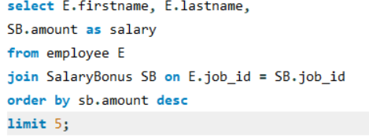


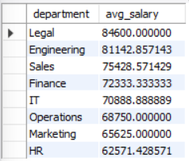
iv. Who are the top 5 highest-paid employees?

Slide 12


V. What is the total salary expenditure across the company?

Slide 13
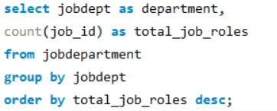

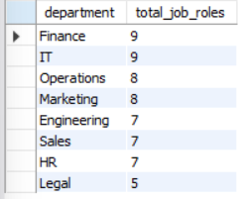
2. JOB ROLE AND DEPARTMENT ANALYSIS
How many different job roles exist in each department?

Slide 14

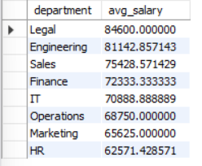
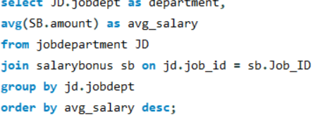
ii. What is the average salary range per department?

Slide 15




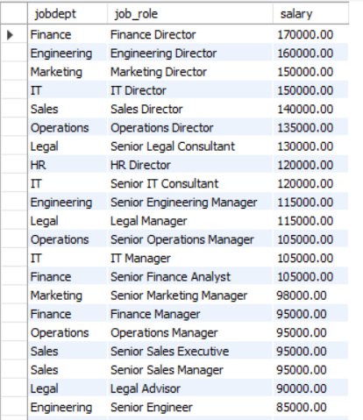

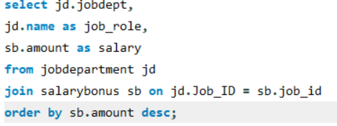
Iii. Which job roles offer the highest salary?

Slide 16


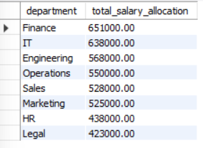
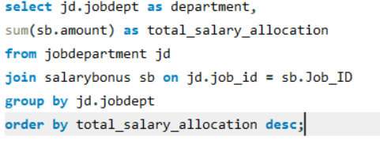
iv. Which departments have the highest total salary allocation?

Slide 17

3. QUALIFICATION AND SKILLS ANALYSIS
How many employees have at least one qualification listed?

Slide 18


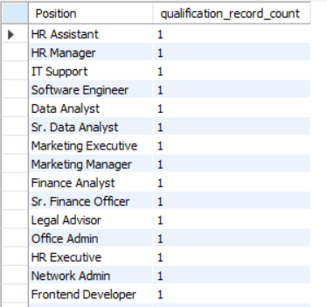
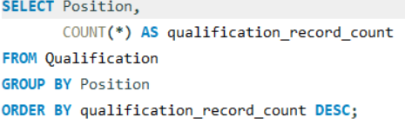
ii. Which positions require the most qualifications?

Slide 19
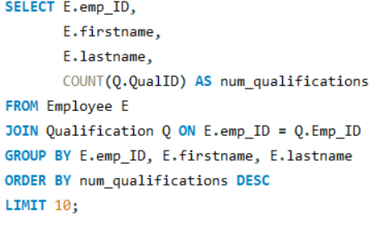
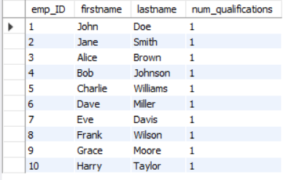
iii. Which employees have the highest number of qualifications?

Slide 20
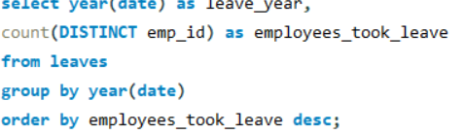

4. LEAVE AND ABSENCE PATTERNS
Which year had the most employees taking leaves?

Slide 21

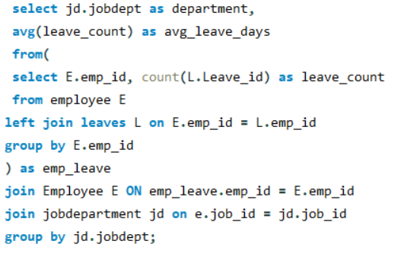
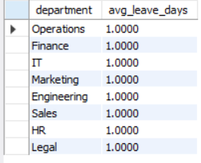
ii. What is the average number of leave days taken by its employees per department?

Slide 22
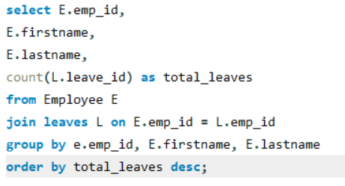
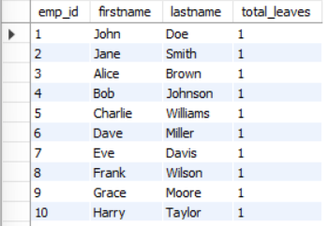

iii. Which employees have taken the most leaves?

Slide 23


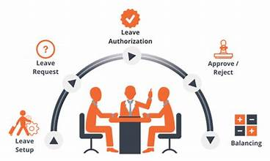
iv. What is the total number of leave days taken company-wide?

Slide 24
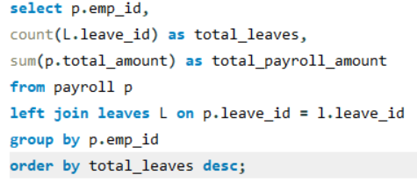
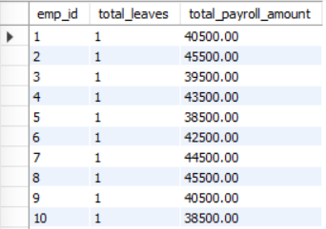
V. How do leave days correlate with payroll amounts?

Slide 25
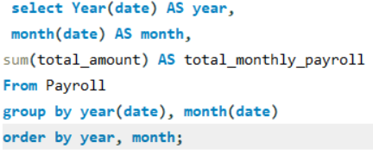

5. PAYROLL AND COMPENSATION ANALYSIS
What is the total monthly payroll processed?

Slide 26
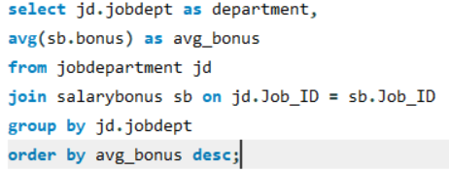
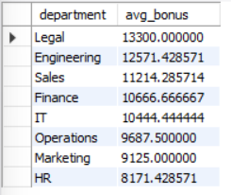
ii. What is the average bonus given per department?

Slide 27
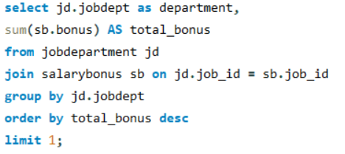

iii.Which department receives the highest total bonuses?

Slide 28
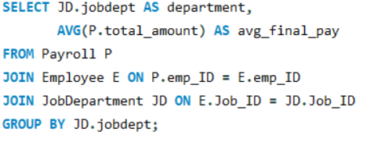
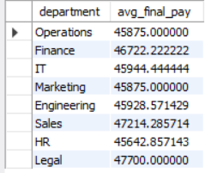

iv. What is the average value of total_amount after consider

Slide 29
Key Insights:
Successfully analyzed multi-table data using SQL JOINs and aggregate functions.
Improved understanding of primary–foreign key relationships and relational database design.
Identified important insights such as employee leave trends and payroll patterns.
Enhanced skills in cleaning data, handling NULL values, and fixing inconsistent formats.
Learned to write efficient queries and validate results for accuracy.

Slide 30
Challenges:
Defining correct table relationships and using foreign keys accurately.
Maintaining data consistency through cascading updates and deletes.
Writing complex JOIN queries for reports combining employee roles, leaves, and payroll.
Ensuring all date fields follow the YYYY-MM-DD format for correct time-based analysis.
Preventing duplicate entries using unique constraints, especially on email fields.

Slide 31
conclusion:
The Employee Management System successfully integrates employee, job, payroll, qualification, and leave information into a well-structured relational database. By designing proper table relationships, applying foreign key constraints, and using cascading actions, the system ensures high data accuracy and consistency. The SQL-based analysis provides clear insights into payroll trends, department performance, salaries, employee qualifications, and leave patterns. Overall, this project demonstrates effective use of SQL for real-world data management and showcases the importance of clean database design, efficient querying, and reliable reporting in organizational HR operations.

Slide 32

THANK YOU

